Slide 1
RUSTikales Rust for advanced coders

Slide 2
Plan for today

Slide 3
Plan for today
Recap

Slide 4
Plan for today
Recap
Smart Pointers

Slide 5
Recap

Slide 6
Recap
Slices allow us to reference contiguous sequences of a collection, instead of the whole collection

Slide 7
Recap
Slices allow us to reference contiguous sequences of a collection, instead of the whole collection
Type signature for Slices is [T]
[T] does not implement the Sized trait → Can‘t use directly, always need a reference

Slide 8
Recap
Slices allow us to reference contiguous sequences of a collection, instead of the whole collection
Type signature for Slices is [T]
&[T] is a special reference made out of two fields
Pointer into original collection
Length of the slice

Slide 9
Recap
Slices allow us to reference contiguous sequences of a collection, instead of the whole collection
Type signature for Slices is [T]
&[T] is a special reference made out of two fields
You can get a Slice of a collection by using ranges as indices

Slide 10
Recap
Slices allow us to reference contiguous sequences of a collection, instead of the whole collection
Type signature for Slices is [T]
&[T] is a special reference made out of two fields
You can get a Slice of a collection by using ranges as indices
Most commonly seen form is the String Slice &str

Slide 11
Recap
Slices allow us to reference contiguous sequences of a collection, instead of the whole collection
Type signature for Slices is [T]
&[T] is a special reference made out of two fields
You can get a Slice of a collection by using ranges as indices
Most commonly seen form is the String Slice &str
String literals are Arrays behind the scenes

Slide 12
Recap
Slices allow us to reference contiguous sequences of a collection, instead of the whole collection
Type signature for Slices is [T]
&[T] is a special reference made out of two fields
You can get a Slice of a collection by using ranges as indices
Most commonly seen form is the String Slice &str
String literals are Arrays behind the scenes
String structs are Vectors behind the scenes

Slide 13
Recap
Slices allow us to reference contiguous sequences of a collection, instead of the whole collection
Type signature for Slices is [T]
&[T] is a special reference made out of two fields
You can get a Slice of a collection by using ranges as indices
Most commonly seen form is the String Slice &str
Normal Ownership and Borrow Checker rules apply

Slide 14
Recap
Slices allow us to reference contiguous sequences of a collection, instead of the whole collection
Type signature for Slices is [T]
&[T] is a special reference made out of two fields
You can get a Slice of a collection by using ranges as indices
Most commonly seen form is the String Slice &str
Normal Ownership and Borrow Checker rules apply
Slices count as immutable borrows
Mutable Slices are also possible

Slide 15
Recap
Slices allow us to reference contiguous sequences of a collection, instead of the whole collection
Type signature for Slices is [T]
&[T] is a special reference made out of two fields
You can get a Slice of a collection by using ranges as indices
Most commonly seen form is the String Slice &str
Normal Ownership and Borrow Checker rules apply
Slices count as immutable borrows
Slices don‘t own any elements

Slide 16
Recap
Slices allow us to reference contiguous sequences of a collection, instead of the whole collection
Type signature for Slices is [T]
&[T] is a special reference made out of two fields
You can get a Slice of a collection by using ranges as indices
Most commonly seen form is the String Slice &str
Normal Ownership and Borrow Checker rules apply
Slices count as immutable borrows
Slices don‘t own any elements
Slices don‘t move or copy any data

Slide 17
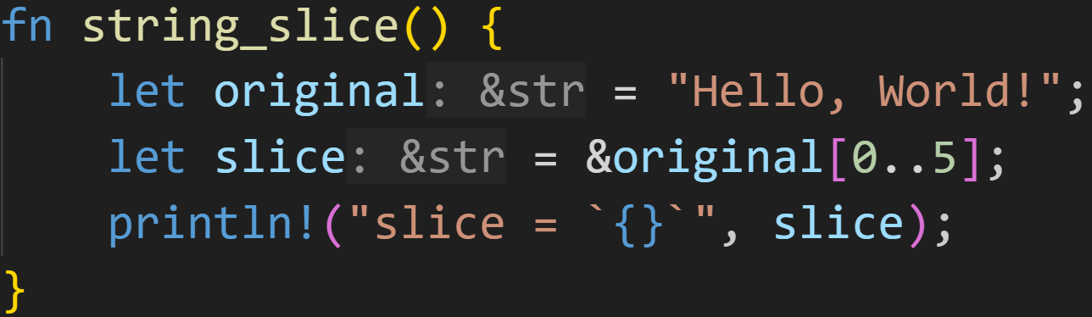
Recap

Slide 18
Recap
String literals are located in the data section of the executable
→ Array of bytes

Slide 19
Recap
Reference into the data section, knows the size of the literal

Slide 20
Recap
Create a slice of the original String

Slide 21
Recap
Borrow the slice
→ Can‘t know at compile time how big the Slice is
→ Must create reference to the Slice

Slide 22
Recap
Still a slice into the data section

Slide 23
Recap
Data Section
H | e | l | l | o | , |  | W | o | r | l | d | !
Stack
original | ptr | ???
 | len | ???
slice | ptr | ???
 | len | ???

Slide 24
Recap
Data Section
H | e | l | l | o | , |  | W | o | r | l | d | !
Stack
original | ptr
 | len | 13
slice | ptr | ???
 | len | ???

Slide 25
Recap
Data Section
H | e | l | l | o | , |  | W | o | r | l | d | !
Stack
original | ptr
 | len | 13
slice | ptr | ???
 | len | ???

Slide 26
Recap
Data Section
H | e | l | l | o | , |  | W | o | r | l | d | !
Stack
original | ptr
 | len | 13
slice | ptr
 | len | 5

Slide 27

Recap
Data Section
H | e | l | l | o | , |  | W | o | r | l | d | !
Stack
original | ptr
 | len | 13
slice | ptr
 | len | 5

Slide 28
Recap
Data Section
H | e | l | l | o | , |  | W | o | r | l | d | !
Stack

Slide 29
Recap
Data Section
H | e | l | l | o | , |  | W | o | r | l | d | !
Stack
String literals have the lifetime ‘static
→ They live for the entire duration of the program

Slide 30
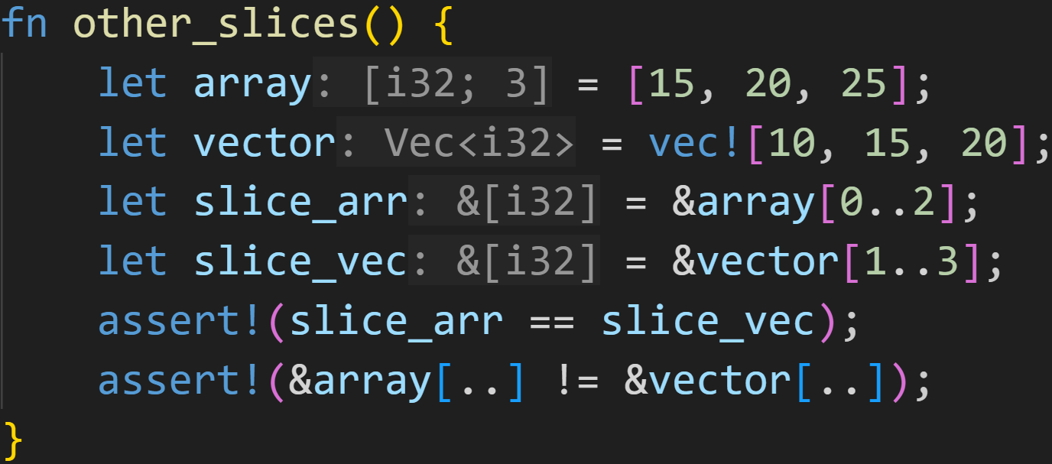
Recap

Slide 31
Recap
You can slice into arrays and vectors

Slide 32
Recap
The collection type info is lost, we only have the elements now

Slide 33
Recap
But that allows us to easily compare different data structures!
Here: Check that some elements in an Array are the same as in a Vector

Slide 34
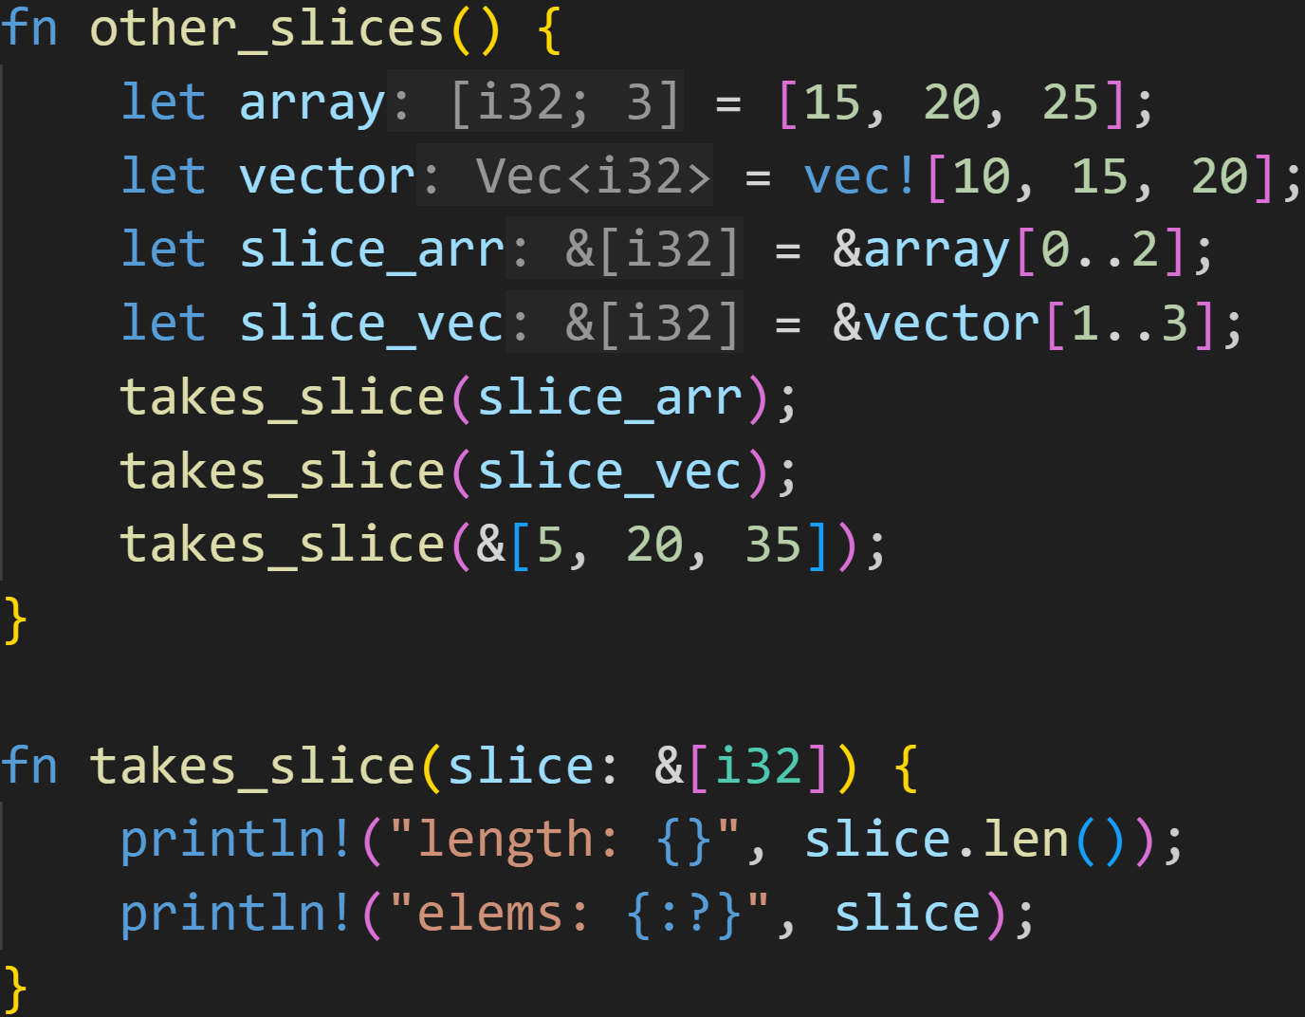
Recap

Slide 35
Recap
Slices allow us to write more efficient functions

Slide 36
Recap
Slices allow us to write more efficient functions → Accepting a Vec<i32> is overkill (needs heap)
→ Big overhead because of .to_vec()

Slide 37
Recap
Slices allow us to write more efficient functions → Accepting a Vec<i32> is overkill → Accepting an Array of i32 is difficult → Must specify a size at compile time

Slide 38
Recap
Slices allow us to write more efficient functions → Accepting a Vec<i32> is overkill → Accepting an Array of i32 is difficult → Slices accept both collections, with little overhead

Slide 39
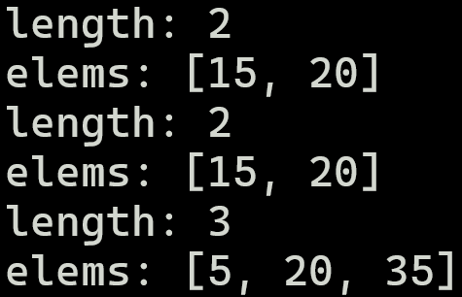
Recap

Slide 40
Smart Pointers

Slide 41
Smart Pointers
Recap on Rust

Slide 42
Smart Pointers
Recap on Rust
Ownership

Slide 43
Smart Pointers
Recap on Rust
Ownership
Every variable, every value, everything in Rust has exactly one owner

Slide 44
Smart Pointers
Recap on Rust
Ownership
Every variable, every value, everything in Rust has exactly one owner
Ownership conflicts are resolved by moving values

Slide 45
Smart Pointers
Recap on Rust
Ownership
Every variable, every value, everything in Rust has exactly one owner
Ownership conflicts are resolved by moving values
When the owner is dropped, the value is dropped (memory is freed) → Statically known → The compiler inserts some code at specific locations to drop values

Slide 46
Smart Pointers
Recap on Rust
Ownership
Borrow Checker

Slide 47
Smart Pointers
Recap on Rust
Ownership
Borrow Checker
Can either get infinite immutable borrows, or a single mutable borrow, but not both at the same time

Slide 48
Smart Pointers
Recap on Rust
Ownership
Borrow Checker
Can either get infinite immutable borrows, or a single mutable borrow, but not both at the same time
Every reference has a Lifetime

Slide 49
Smart Pointers
Recap on Rust
Ownership
Borrow Checker
Memory Safety guarantees

Slide 50
Smart Pointers
Recap on Rust
Ownership
Borrow Checker
Memory Safety guarantees
The compiler is very conservative

Slide 51
Smart Pointers
Recap on Rust
Ownership
Borrow Checker
Memory Safety guarantees
The compiler is very conservative → If a program obeys those rules, it is valid Rust code → If the compiler can‘t statically prove that, it has to reject the code

Slide 52
Smart Pointers
If the compiler can‘t statically prove that the code obeys the rules, it has to reject the code

Slide 53
Smart Pointers
If the compiler can‘t statically prove that the code obeys the rules, it has to reject the code
It is really easy to write code that brings the compiler to its limit

Slide 54
Smart Pointers
If the compiler can‘t statically prove that the code obeys the rules, it has to reject the code
It is really easy to write code that brings the compiler to its limit
Cyclic data structures

Slide 55
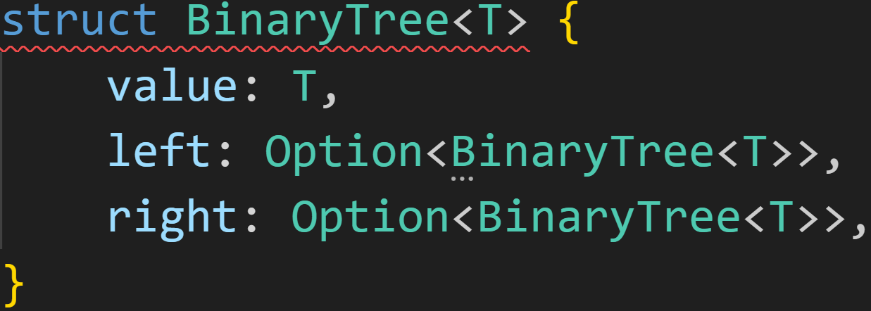
Smart Pointers
If the compiler can‘t statically prove that the code obeys the rules, it has to reject the code

Slide 56
Smart Pointers
If the compiler can‘t statically prove that the code obeys the rules, it has to reject the code
Structs need to be Sized, the size must be known at compile time.
How big are recursive structs?

Slide 57
Smart Pointers
If the compiler can‘t statically prove that the code obeys the rules, it has to reject the code
It is really easy to write code that brings the compiler to its limit
Cyclic data structures
Shared Ownership vs No Ownership at all

Slide 58
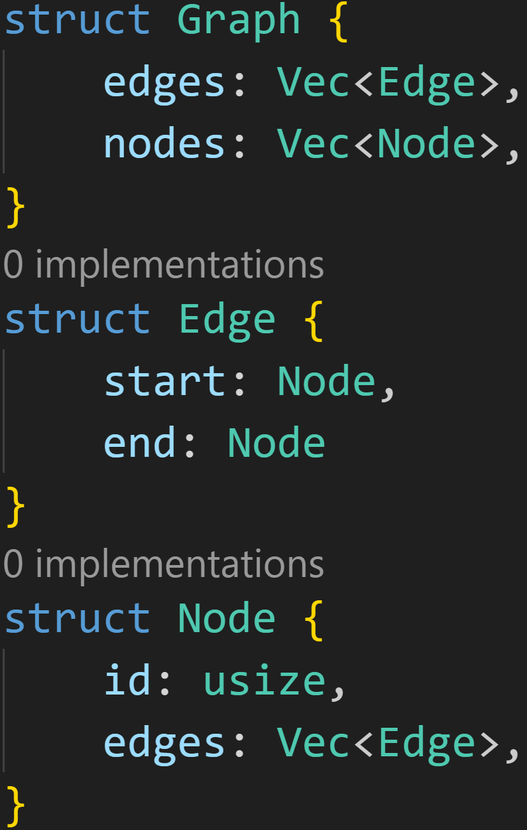
Smart Pointers

Slide 59
Smart Pointers
Who owns what?

Slide 60
Smart Pointers
Who owns what?
Graph
edges
edge1
edge2
edge3
nodes
node1
node2
node3

Slide 61
Smart Pointers
Who owns what?
Graph
edges
edge1
edge2
edge3
nodes
node1
node2
node3
start
id | node1
edges | ???
start
id | node2
edges | ???
start
id | node3
edges | ???

Slide 62
Smart Pointers
Who owns what?
Graph
edges
edge1
edge2
edge3
nodes
node1
node2
node3
start
id | node1
edges | ???
start
id | node2
edges | ???
We have multiple copies of the same nodes!
start
id | node3
edges | ???

Slide 63
Smart Pointers
What we actually want:
Graph
edges
edge1
edge2
edge3
nodes
node1
node2
node3
start
ptr | node1
start
ptr | node2
start
ptr | node3

Slide 64
Smart Pointers
What we actually want:
Graph
edges
edge1
edge2
edge3
nodes
node1
node2
node3
start
ptr | node1
start
ptr | node2
start
ptr | node3
edges
ptr | edge1
ptr | edge2

Slide 65
Smart Pointers
If the compiler can‘t statically prove that the code obeys the rules, it has to reject the code
It is really easy to write code that brings the compiler to its limit
Cyclic data structures
Shared Ownership vs No Ownership at all
Convoluted code where we can‘t analyze what‘s borrowed, and where, and how

Slide 66
Smart Pointers
If the compiler can‘t statically prove that the code obeys the rules, it has to reject the code
It is really easy to write code that brings the compiler to its limit
Cyclic data structures
Shared Ownership vs No Ownership at all
Convoluted code where we can‘t analyze what‘s borrowed, and where, and how
In those situations (and some more) we need to use Smart Pointers

Slide 67
Smart Pointers
Smart Pointers are data structures that act as normal references

Slide 68
Smart Pointers
Smart Pointers are data structures that act as normal references
They implement the Deref trait (and sometimes DerefMut) → Unary operator * to access the underlying data

Slide 69
Smart Pointers
Smart Pointers are data structures that act as normal references
They implement the Deref trait (and sometimes DerefMut)
Additionally, they contain extra metadata and implement specific behavior

Slide 70
Smart Pointers
Smart Pointers are data structures that act as normal references
They implement the Deref trait (and sometimes DerefMut)
Additionally, they contain extra metadata and implement specific behavior
More generally: Smart Pointers are a design pattern
You can easily write your own Smart Pointers, many libraries offer their own variations
As with every design pattern, they have pros and cons

Slide 71
Smart Pointers
The most straightforward Smart Pointer is Box<T>

Slide 72
Smart Pointers
The most straightforward Smart Pointer is Box<T>
Box<T> doesn‘t offer much utility, it only puts the encapsulated value on the heap, instead of storing it on the stack

Slide 73
Smart Pointers
The most straightforward Smart Pointer is Box<T>
Box<T> doesn‘t offer much utility, it only puts the encapsulated value on the heap, instead of storing it on the stack
Box<T> owns the underlying data → Data is dropped when Box is dropped

Slide 74
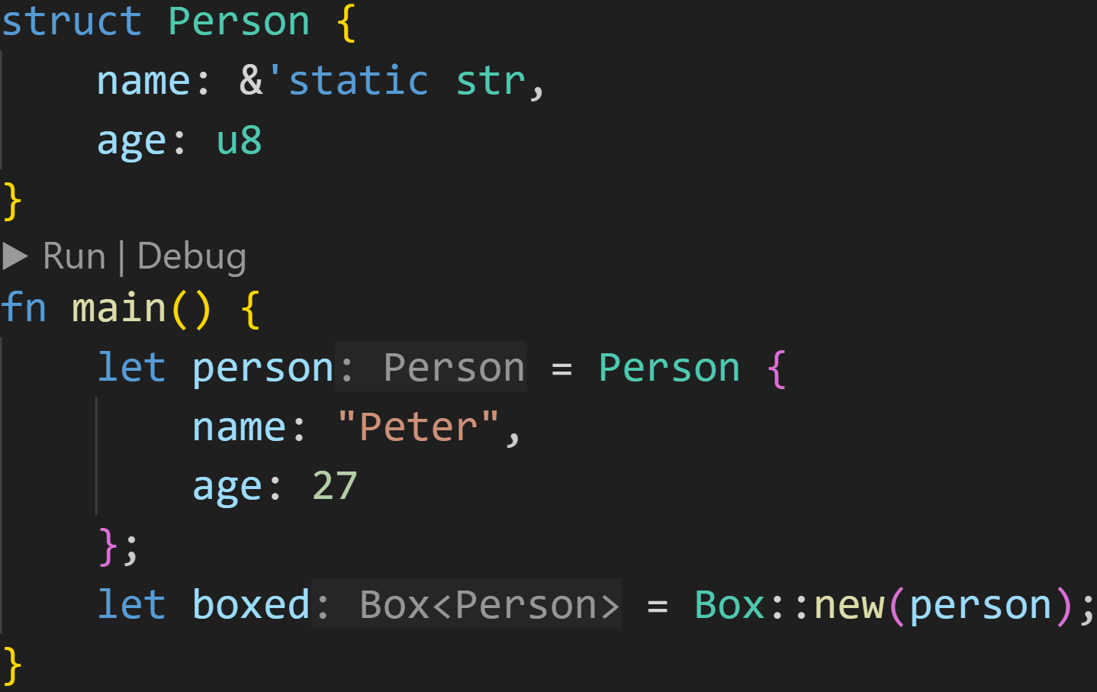
Smart Pointers

Slide 75
Smart Pointers
Similar to Option and Result, Box is part of the prelude → No special imports necessary

Slide 76
Smart Pointers
Moves the person into the Heap

Slide 77
Smart Pointers
Stack
person | name | ???
 | age | ???
boxed | ptr | ???

Slide 78
Smart Pointers
Stack
person | name | Peter
 | age | 27
boxed | ptr | ???

Slide 79
Smart Pointers
Stack
person | name | ???
 | age | ???
boxed | ptr | 0x1230
Heap
0x1230 | name | Peter
0x1234 | age | 27

Slide 80
Smart Pointers
Underlying value is dropped when the box is dropped
Stack
Heap

Slide 81
Smart Pointers
The most straightforward Smart Pointer is Box<T>
Box<T> doesn‘t offer much utility, it only puts the encapsulated value on the heap, instead of storing it on the stack
Box<T> owns the underlying data
Because of that, Box<T> is often used in recursive data structures
It doesn‘t matter how big the underlying structure is, Box<T> is always pointer sized

Slide 82
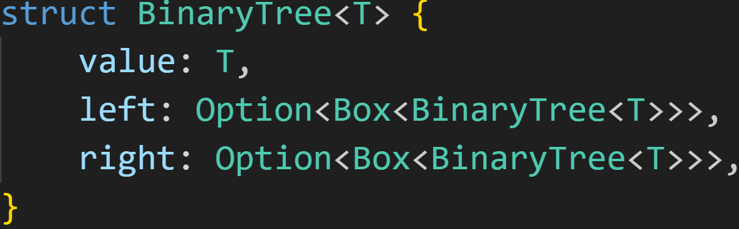
Smart Pointers

Slide 83
Smart Pointers
Add indirection by putting the nodes into a Box

Slide 84
Smart Pointers
Sizeof BinaryTree<T> = Sizeof<value> + Sizeof<left> + Sizeof<right>

Slide 85
Smart Pointers
Sizeof BinaryTree<T> = Sizeof<value> + Sizeof<left> + Sizeof<right>
Sizeof BinaryTree<i32> = Sizeof<i32> + 2 * Sizeof<Option<Box<BinaryTree<i32>>>>

Slide 86
Smart Pointers
Sizeof BinaryTree<T> = Sizeof<value> + Sizeof<left> + Sizeof<right>
Sizeof BinaryTree<i32> = Sizeof<i32> + 2 * Sizeof<Option<Box<BinaryTree<i32>>>>
Sizeof BinaryTree<i32> = 4 + 2 * Sizeof<Box<BinaryTree<i32>>>

Slide 87
Smart Pointers
Sizeof BinaryTree<T> = Sizeof<value> + Sizeof<left> + Sizeof<right>
Sizeof BinaryTree<i32> = Sizeof<i32> + 2 * Sizeof<Option<Box<BinaryTree<i32>>>>
Sizeof BinaryTree<i32> = 4 + 2 * Sizeof<Box<BinaryTree<i32>>>
Enums are always as big as the biggest variant:
None → 0 bytes
Some(T) -> Sizeof<T>
+1 byte to store which variant it is (the tag), but Option is optimized, we don‘t have that here

Slide 88
Smart Pointers
Sizeof BinaryTree<T> = Sizeof<value> + Sizeof<left> + Sizeof<right>
Sizeof BinaryTree<i32> = Sizeof<i32> + 2 * Sizeof<Option<Box<BinaryTree<i32>>>>
Sizeof BinaryTree<i32> = 4 + 2 * Sizeof<Box<BinaryTree<i32>>>
Sizeof BinaryTree<i32> = 4 + 2 * 8 (or 4 on 32bit-systems)

Slide 89
Smart Pointers
Sizeof BinaryTree<T> = Sizeof<value> + Sizeof<left> + Sizeof<right>
Sizeof BinaryTree<i32> = Sizeof<i32> + 2 * Sizeof<Option<Box<BinaryTree<i32>>>>
Sizeof BinaryTree<i32> = 4 + 2 * Sizeof<Box<BinaryTree<i32>>>
Sizeof BinaryTree<i32> = 4 + 2 * 8
Sizeof BinaryTree<i32> = 20 bytes

Slide 90
Smart Pointers
Sizeof BinaryTree<T> = Sizeof<value> + Sizeof<left> + Sizeof<right>
Sizeof BinaryTree<i32> = Sizeof<i32> + 2 * Sizeof<Option<Box<BinaryTree<i32>>>>
Sizeof BinaryTree<i32> = 4 + 2 * Sizeof<Box<BinaryTree<i32>>>
Sizeof BinaryTree<i32> = 4 + 2 * 8
Sizeof BinaryTree<i32> = 20 bytes + 4 bytes alignment = 24 bytes :^)

Slide 91
Smart Pointers
The most straightforward Smart Pointer is Box<T>
Box<T> doesn‘t offer much utility, it only puts the encapsulated value on the heap, instead of storing it on the stack
Box<T> owns the underlying data
Because of that, Box<T> is often used in recursive data structures
It doesn‘t matter how big the underlying structure is, Box<T> is always pointer sized
Another usecase is when you have a large amount of data, and want to move it a lot

Slide 92
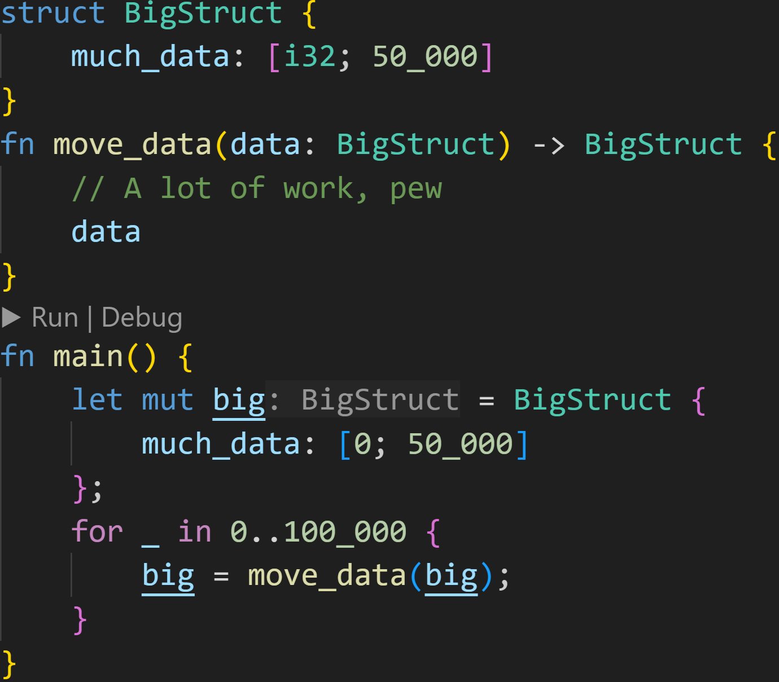
Smart Pointers

Slide 93
Smart Pointers
Struct is 200KB big
→ Move 200KB when passing big as argument → Move 200KB when putting the return value into big

Slide 94
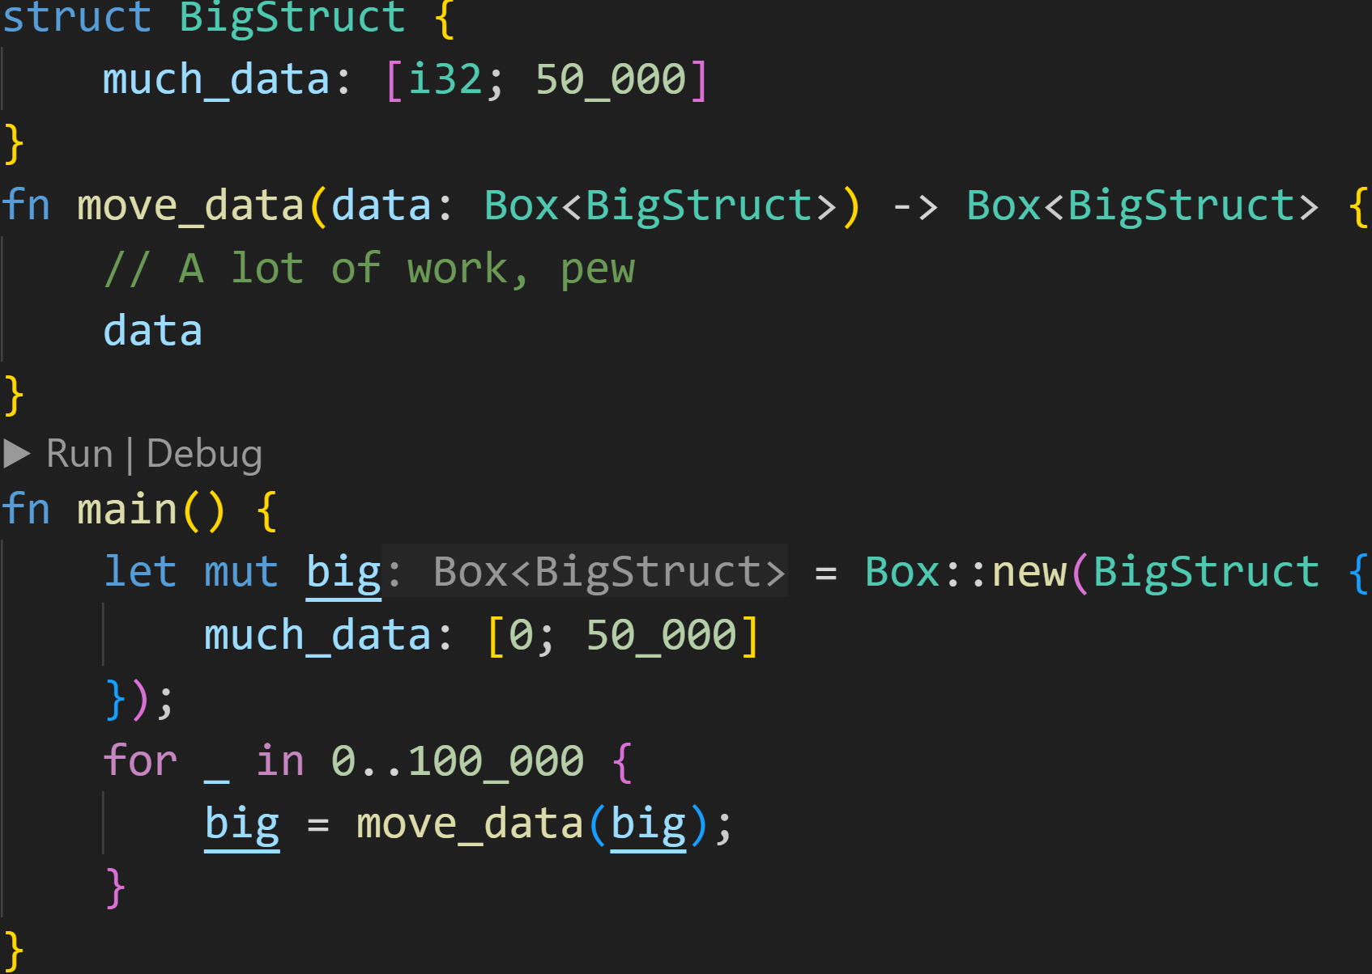
Smart Pointers
When working with a Box, we now only need to pass 8 bytes!

Slide 95
Smart Pointers
Another useful Smart Pointer is Rc<T>

Slide 96
Smart Pointers
Another useful Smart Pointer is Rc<T>
Rc stands for Reference Counted, and does exactly what you might think it does → It counts references

Slide 97
Smart Pointers
Another useful Smart Pointer is Rc<T>
Rc stands for Reference Counted, and does exactly what you might think it does → It counts references
Rc<T> is used for Shared Ownership

Slide 98
Smart Pointers
Another useful Smart Pointer is Rc<T>
Rc stands for Reference Counted, and does exactly what you might think it does → It counts references
Rc<T> is used for Shared Ownership
Rc<T> handles Ownership at Runtime, instead of Compiletime

Slide 99
Smart Pointers
Another useful Smart Pointer is Rc<T>
Rc stands for Reference Counted, and does exactly what you might think it does → It counts references
Rc<T> is used for Shared Ownership
Rc<T> handles Ownership at Runtime, instead of Compiletime
Every time you clone a Rc<T>, the reference count increases by one

Slide 100
Smart Pointers
Another useful Smart Pointer is Rc<T>
Rc stands for Reference Counted, and does exactly what you might think it does → It counts references
Rc<T> is used for Shared Ownership
Rc<T> handles Ownership at Runtime, instead of Compiletime
Every time you clone a Rc<T>, the reference count increases by one
Every time you drop a Rc<T>, the reference count decreases by one

Slide 101
Smart Pointers
Another useful Smart Pointer is Rc<T>
Rc stands for Reference Counted, and does exactly what you might think it does → It counts references
Rc<T> is used for Shared Ownership
Rc<T> handles Ownership at Runtime, instead of Compiletime
Every time you clone a Rc<T>, the reference count increases by one
Every time you drop a Rc<T>, the reference count decreases by one
The underlying data is dropped when the reference count reaches 0

Slide 102
Smart Pointers
Another useful Smart Pointer is Rc<T>
Rc stands for Reference Counted, and does exactly what you might think it does → It counts references
Rc<T> is used for Shared Ownership
Rc<T> handles Ownership at Runtime, instead of Compiletime
Because of Shared Ownership, the underlying data is immutable by default → But we can fix that later

Slide 103
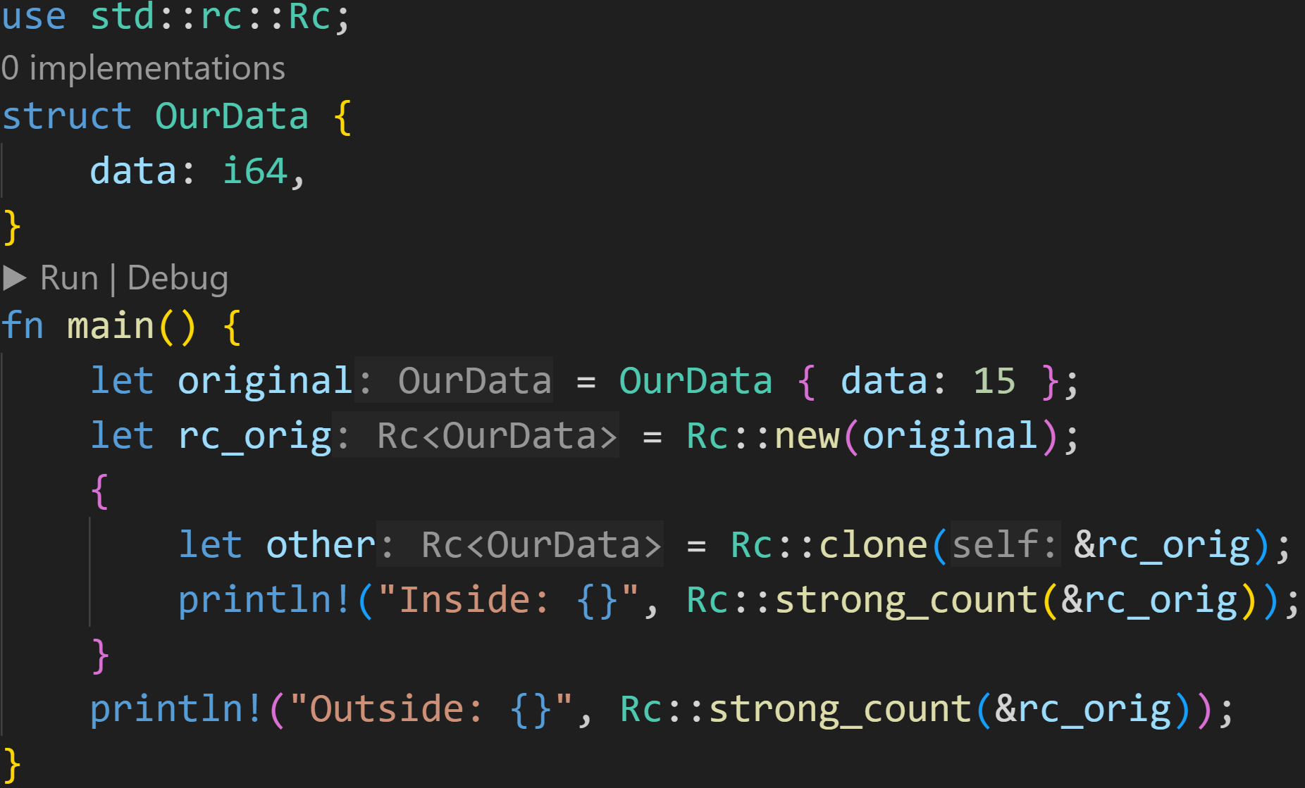
Smart Pointers

Slide 104
Smart Pointers
Rc is part of the standard library, needs to be imported first

Slide 105
Smart Pointers
Create a reference counted version of the original
→ Ownership is moved into the Rc → Heap

Slide 106
Smart Pointers
Create a copy of the Rc

Slide 107
Smart Pointers
Note: It‘s Rust-idiomatic to write method calls of Rc as associated function
Create a copy of the Rc

Slide 108
Smart Pointers
Note: It‘s Rust-idiomatic to write method calls of Rc as associated function → rc_orig.clone() might make you think that you clone the underlying data
Create a copy of the Rc

Slide 109
Smart Pointers
Note: It‘s Rust-idiomatic to write method calls of Rc as associated function → rc_orig.clone() might make you think that you clone the underlying data → But you‘re just cloning the Rc-Metadata
Create a copy of the Rc

Slide 110
Smart Pointers
Returns the current reference count

Slide 111
Smart Pointers
Stack
original | ???
rc_orig | ???
other | ???

Slide 112
Smart Pointers
Stack
original | OurData<15>
rc_orig | ???
other | ???

Slide 113
Smart Pointers
Stack
original | ???
rc_orig | 0x1000
other | ???
Heap
0x1000 | data | OurData<15>
0x1008 | count | 1

Slide 114
Smart Pointers
Note: The original data was moved!
Stack
original | ???
rc_orig | 0x1000
other | ???
Heap
0x1000 | data | OurData<15>
0x1008 | count | 1

Slide 115
Smart Pointers
Stack
original | ???
rc_orig | 0x1000
other | 0x1000
Heap
0x1000 | data | OurData<15>
0x1008 | count | 2

Slide 116
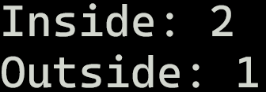
Smart Pointers
Stack
original | ???
rc_orig | 0x1000
other | 0x1000
Heap
0x1000 | data | OurData<15>
0x1008 | count | 2

Slide 117
Smart Pointers
Call to drop(other) → Decrement count
Stack
original | ???
rc_orig | 0x1000
other | ???
Heap
0x1000 | data | OurData<15>
0x1008 | count | 1

Slide 118
Smart Pointers
Stack
original | ???
rc_orig | 0x1000
other | ???
Heap
0x1000 | data | OurData<15>
0x1008 | count | 1

Slide 119
Smart Pointers
Call to drop(rc_orig) → Decrement count
Stack
original | ???
rc_orig | 0x1000
other | ???
Heap
0x1000 | data | OurData<15>
0x1008 | count | 0

Slide 120
Smart Pointers
Call to drop(rc_orig) → Decrement count → count is zero → drop data
Stack
original | ???
rc_orig | 0x1000
other | ???
Heap
0x1000 | data | ???
0x1008 | count | 0

Slide 121
Smart Pointers
Stack

Slide 122
Smart Pointers
Rc<T> by itself is very useful, but it‘s quite limited
Because of aliasing, you can only ever borrow immutably, but not mutably

Slide 123
Smart Pointers
Rc<T> by itself is very useful, but it‘s quite limited
In many situations you actually want a mutable reference counted value

Slide 124
Smart Pointers
Rc<T> by itself is very useful, but it‘s quite limited
In many situations you actually want a mutable reference counted value
This is where RefCell<T> enters the field

Slide 125
Smart Pointers
The third often used Smart Pointer is RefCell<T>

Slide 126
Smart Pointers
The third often used Smart Pointer is RefCell<T>
RefCell<T> belongs to a group of data structures called Cells

Slide 127
Smart Pointers
The third often used Smart Pointer is RefCell<T>
RefCell<T> belongs to a group of data structures called Cells
All Cells utilize a mechanism called Interior Mutability

Slide 128
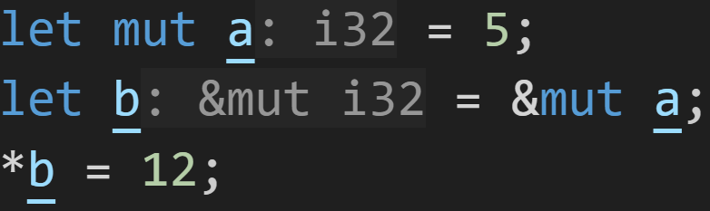
Smart Pointers
The third often used Smart Pointer is RefCell<T>
RefCell<T> belongs to a group of data structures called Cells
All Cells utilize a mechanism called Interior Mutability
Normally you can only modify references via &mut T → Inherited Mutability

Slide 129
Smart Pointers
The third often used Smart Pointer is RefCell<T>
RefCell<T> belongs to a group of data structures called Cells
All Cells utilize a mechanism called Interior Mutability
Normally you can only modify references via &mut T → Inherited Mutability
Need mutable values and references → Checked at compile time

Slide 130
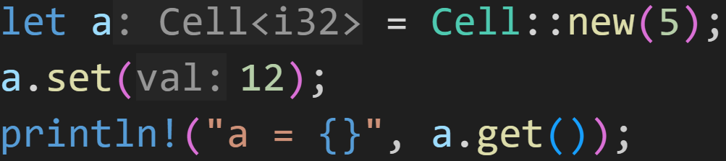
Smart Pointers
The third often used Smart Pointer is RefCell<T>
RefCell<T> belongs to a group of data structures called Cells
All Cells utilize a mechanism called Interior Mutability
Normally you can only modify references via &mut T → Inherited Mutability
Interior Mutability allows you to modify references via &T

Slide 131
Smart Pointers
The third often used Smart Pointer is RefCell<T>
RefCell<T> belongs to a group of data structures called Cells
All Cells utilize a mechanism called Interior Mutability
Normally you can only modify references via &mut T → Inherited Mutability
Interior Mutability allows you to modify references via &T
Not mutable!

Slide 132

Smart Pointers
The third often used Smart Pointer is RefCell<T>
RefCell<T> belongs to a group of data structures called Cells
All Cells utilize a mechanism called Interior Mutability
Normally you can only modify references via &mut T → Inherited Mutability
Interior Mutability allows you to modify references via &T
Not mutable!
Yet...

Slide 133
Smart Pointers
The third often used Smart Pointer is RefCell<T>
RefCell<T> belongs to a group of data structures called Cells
All Cells utilize a mechanism called Interior Mutability
All Cells are equally unique and important, I will only cover RefCell<T> today
Cell<T>
RefCell<T>
OnceCell<T>

Slide 134
Smart Pointers
The third often used Smart Pointer is RefCell<T>
RefCell<T> belongs to a group of data structures called Cells
All Cells utilize a mechanism called Interior Mutability
All Cells are equally unique and important, I will only cover RefCell<T> today
RefCell<T> uses Interior Mutability to allow Borrow Checking at Runtime

Slide 135
Smart Pointers
RefCell<T> uses Interior Mutability to allow Borrow Checking at Runtime
Similar to how Rc<T> keeps track of references, RefCell<T> keeps track of current borrows

Slide 136
Smart Pointers
RefCell<T> uses Interior Mutability to allow Borrow Checking at Runtime
Similar to how Rc<T> keeps track of references, RefCell<T> keeps track of current borrows
Using borrow() and borrow_mut(), you can borrow the underlying data of RefCell<T>

Slide 137
Smart Pointers
RefCell<T> uses Interior Mutability to allow Borrow Checking at Runtime
Similar to how Rc<T> keeps track of references, RefCell<T> keeps track of current borrows
Using borrow() and borrow_mut(), you can borrow the underlying data of RefCell<T>
Borrows are valid until the end of the scope
Rule of thumb: Keep scopes as short as possible, use separate blocks {} if necessary

Slide 138
Smart Pointers
RefCell<T> uses Interior Mutability to allow Borrow Checking at Runtime
Similar to how Rc<T> keeps track of references, RefCell<T> keeps track of current borrows
Using borrow() and borrow_mut(), you can borrow the underlying data of RefCell<T>
Borrows are valid until the end of the scope
If you violate the Borrow Checking rules, you‘ll get a panic at runtime!

Slide 139
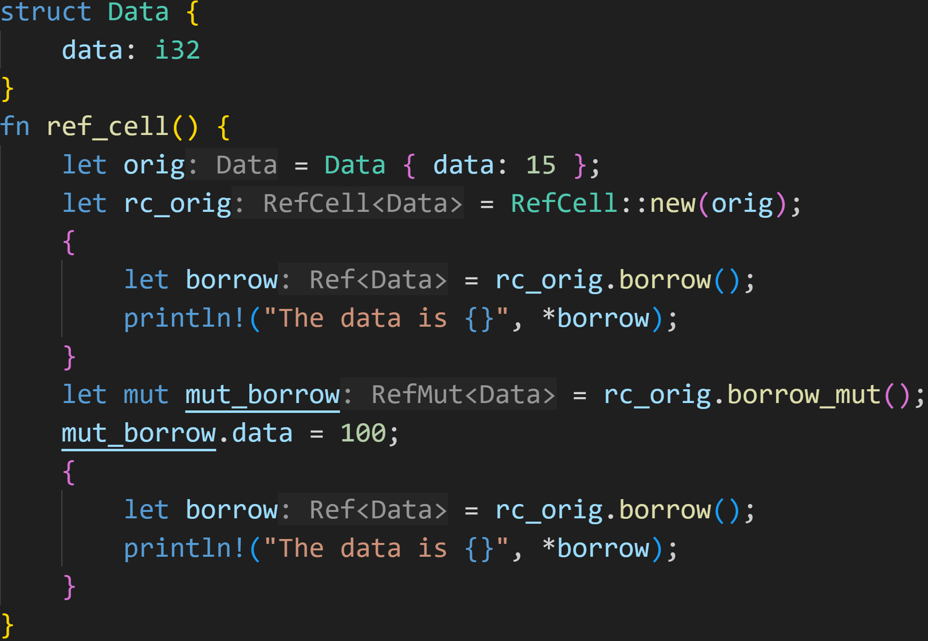
Smart Pointers

Slide 140
Smart Pointers
Create RefCell

Slide 141
Smart Pointers
Immutable :^)

Slide 142
Smart Pointers
Immutable borrow in this block

Slide 143

Smart Pointers

Slide 144
Smart Pointers
Mutable borrow, update the data

Slide 145
Smart Pointers
Immutable borrow, print the data again

Slide 146
Smart Pointers
HOWEVER!

Slide 147
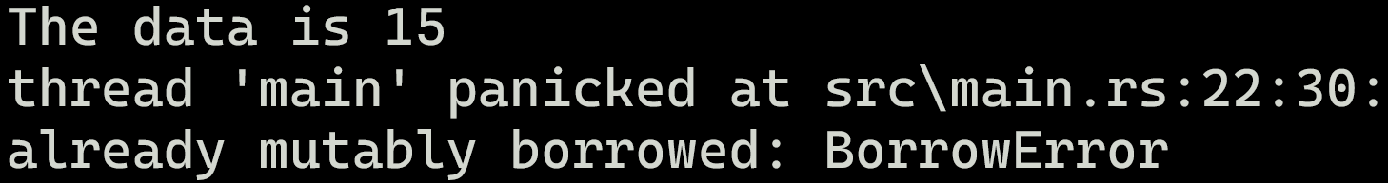
Smart Pointers
HOWEVER!

Slide 148
Smart Pointers
We just can‘t escape it... :(
Mutable borrow in this block!
Borrow Checker violation!

Slide 149
Smart Pointers
Using a combination of Smart Pointers, we can now implement fancy data structures

Slide 150
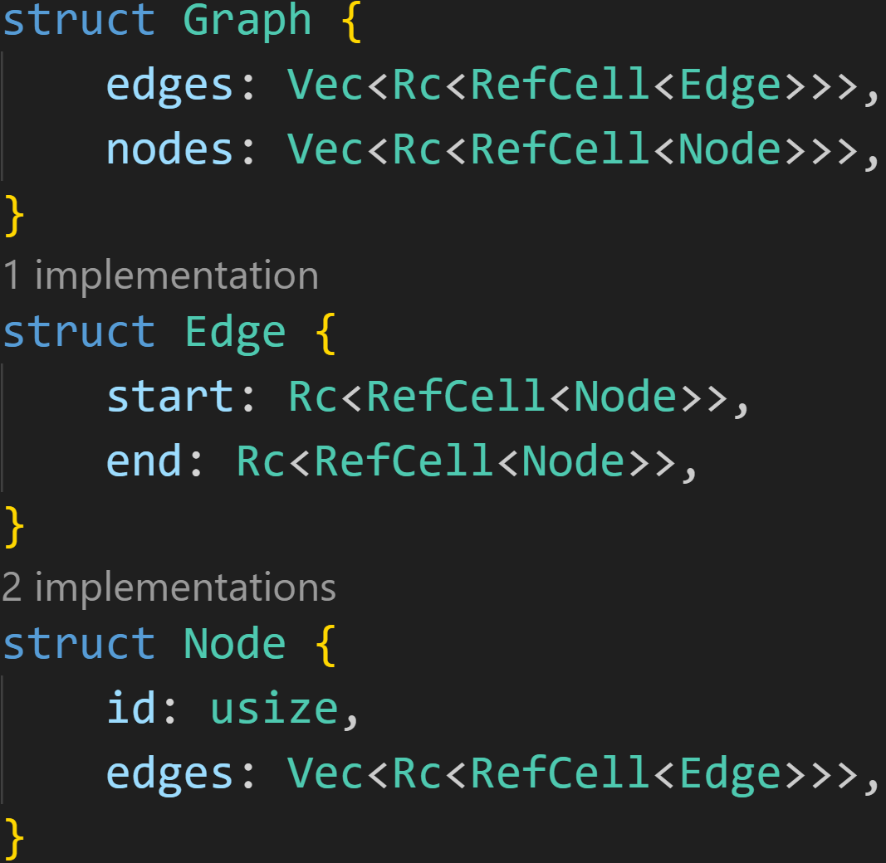
Smart Pointers

Slide 151
Smart Pointers
Edges and Nodes are now shared

Slide 152
Smart Pointers
Edges and Nodes are now shared
→ RefCell<> to modify them (e.g. to add an Edge to a Node)

Slide 153
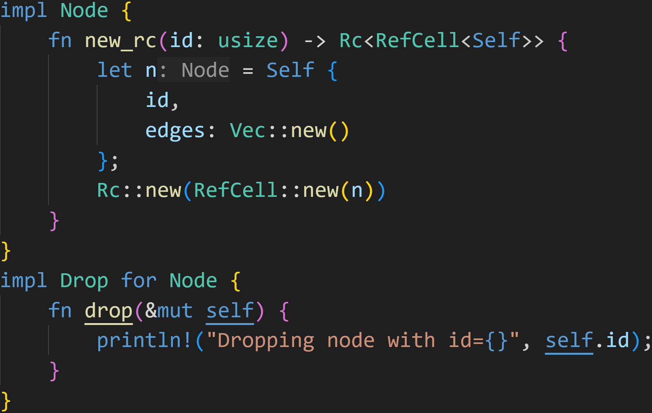
Smart Pointers

Slide 154
Smart Pointers
Helper function to easily create smart Nodes

Slide 155
Smart Pointers
This is called when we drop a Node

Slide 156
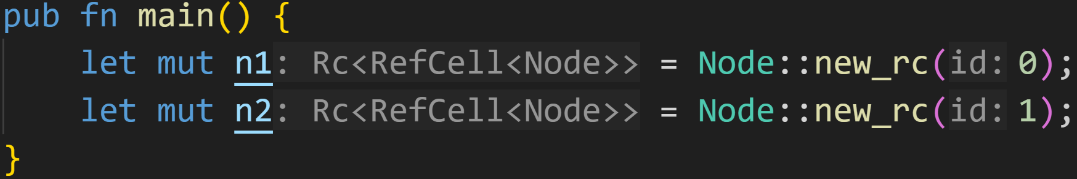
Smart Pointers

Slide 157
Smart Pointers
Create two nodes with id=0 and id=1

Slide 158
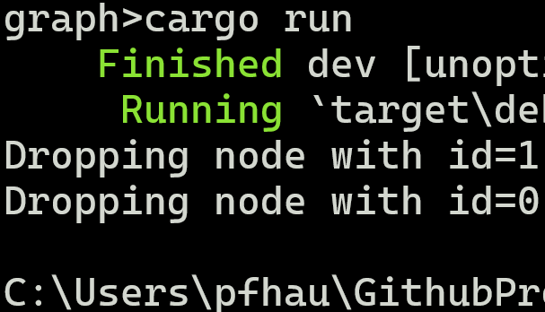
Smart Pointers

Slide 159
Smart Pointers
Variables are always dropped in the reverse order they‘re defined in

Slide 160
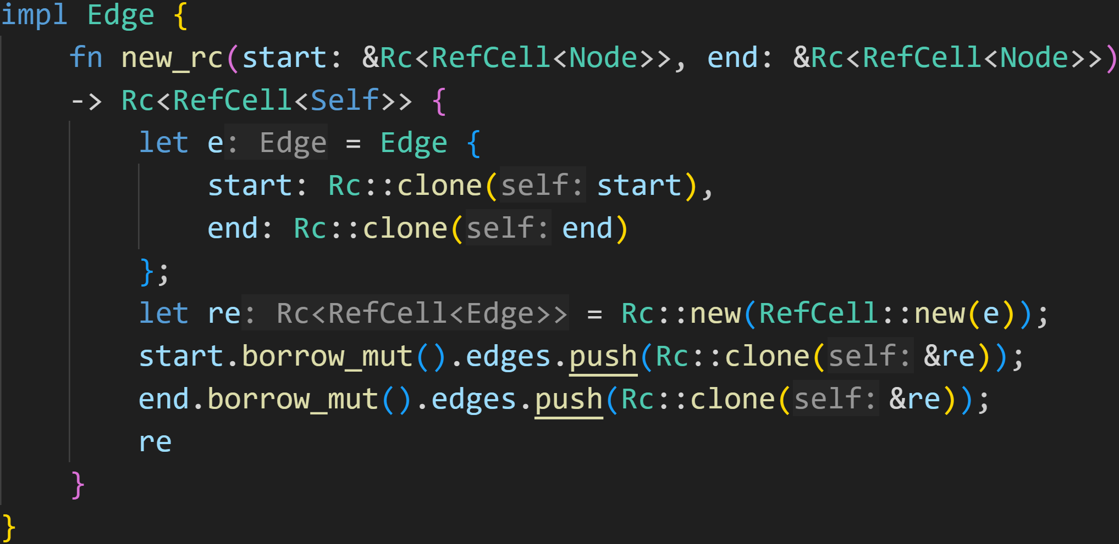
Smart Pointers

Slide 161
Smart Pointers
Create smart Edge

Slide 162
Smart Pointers
Borrow original nodes, and add the Edge to them

Slide 163
Smart Pointers
No mut anywhere, yet this still works :^)
Borrow original nodes, and add the Edge to them

Slide 164
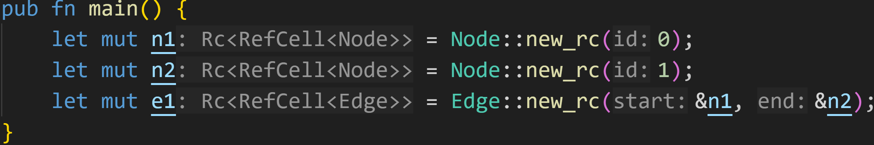
Smart Pointers

Slide 165
Smart Pointers
Create new Edge between both Nodes

Slide 166
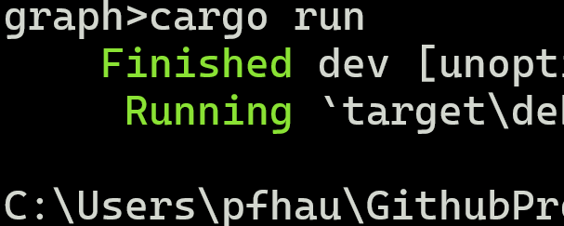
Smart Pointers

Slide 167
Smart Pointers
Congratulations!
We created a memory leak!

Slide 168
Next time
Fixing memory leaks in Rust
Declarative Macros

